Slide 1
NC&YC Work Placement
CO4044 CPD
By Daniel Elstob

Slide 2
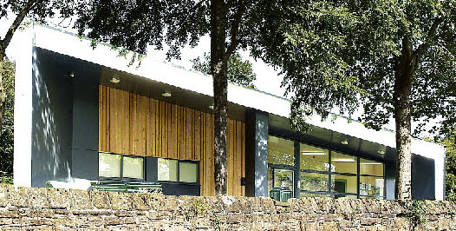
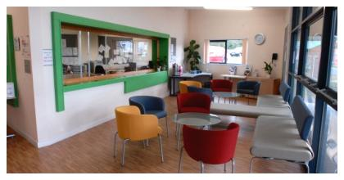
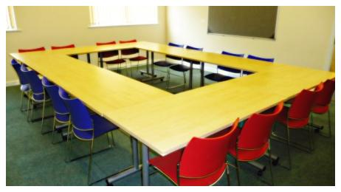
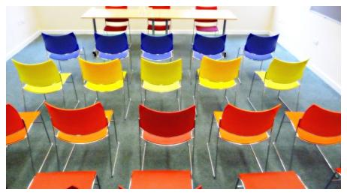
NC&YC
Community Centre offering activities, classes, meetings and room hire
Team - Helen Barrie, Gareth, Rob
Notes:
For the work experience I took a placement at Neston Youth and Community Centre, a centre that offers a range of activities, classes, meetings and room hire.
The team that I worked with consisted of my supervisor Helen Barrie, Gareth (works with the council), Rob (volunteer worker).
The main purpose of my being there was to help design and create a website to help advertise to a new and wider audience and bring in new clients.

Slide 3
Communication skills
Planning meetings with the staff
Giving design views from youth point of view in the meeting
Planning meeting with supervisor
Communicating between WeMakeJam and NC&YC
Notes:
Transferable target – Communication skills.
Planning meeting with staff – The meeting was to design the website. As they had different areas of work it was difficult to gather them all at the same time.
Giving design views from youth point of view – As I was the youngest of group, I helped with the design of website and the language used which potentially unsuitable for teenagers.
Planning meeting with supervisor – This was to see how I was doing, what the next steps were and if there were any new tasks.
Communicating between WeMakeJam and NC&YC – Toward the start of the website creation a company from Manchester called stardotstar were holding their own project called WeMakeJam and offered NC&YC a position in a trail for their new website building software. I would become a middleman between the two.

Slide 4
Time management
Planning meetings with planning group
Planning meetings with supervisor
Finishing tasks on time e.g. website designs, draft website
Notes:
Transferable target – Communication skills.
Planning meeting with planning group – to design the website as they had different areas of work it was difficult to gather them all at the same time.
Planning meeting with supervisor – to see how I’m doing, what the next step were, new tasks.
Finishing website on time to show supervisor.

Slide 5
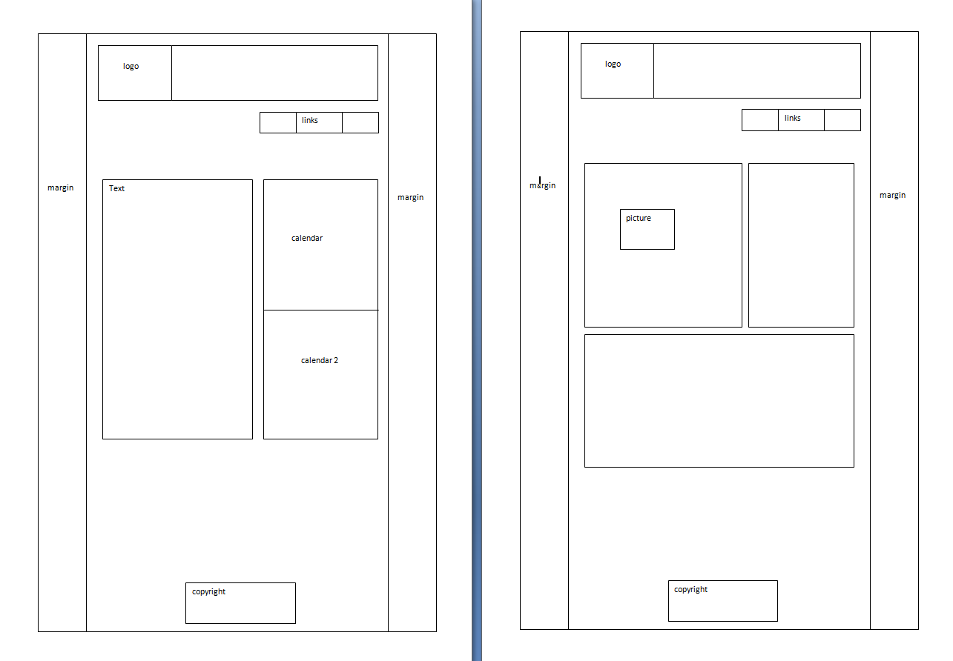
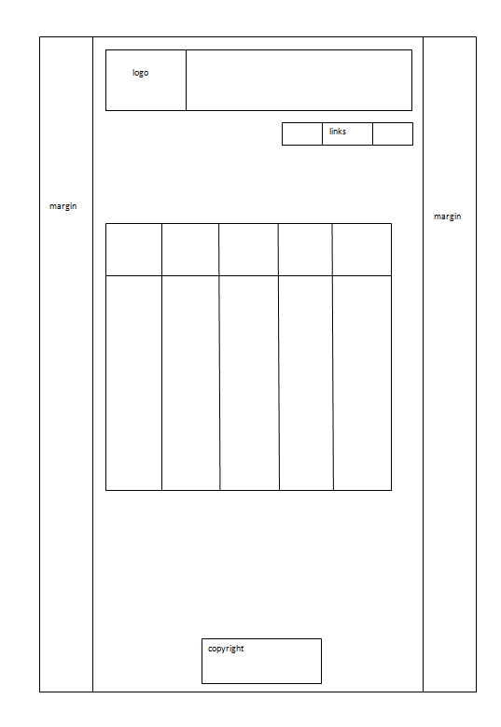
First Designs
Staff meet to plan website design
Notes:
After meeting the staff they planned a meeting to start designing the website
Website design decided on (shown)
A Home page, About Us page and Courses page

Slide 6
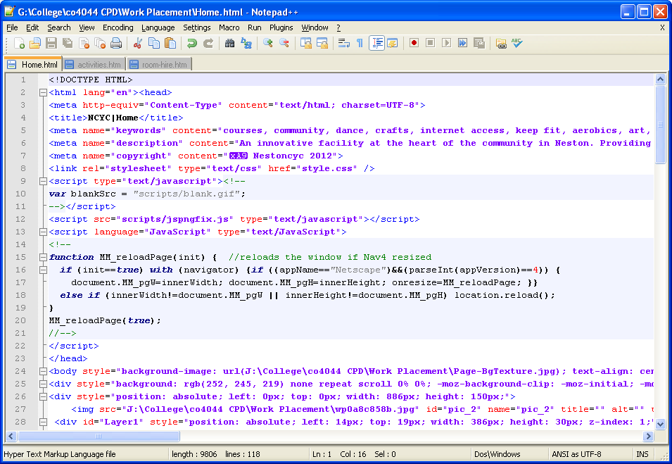
Advance web design skills
HMTL 5
JavaScript
Notes:
Practical target – Advance web design skills.
Created website using HTML 5 and JavaScript.
HTML5 - While some feature will not be available to certain browsers or older versions of browsers, the staff a I decide that html 5 would allow more flexibility when creating the website and would load faster.
MySQL was to be used later however was never learnt due to setbacks later in time.

Slide 7
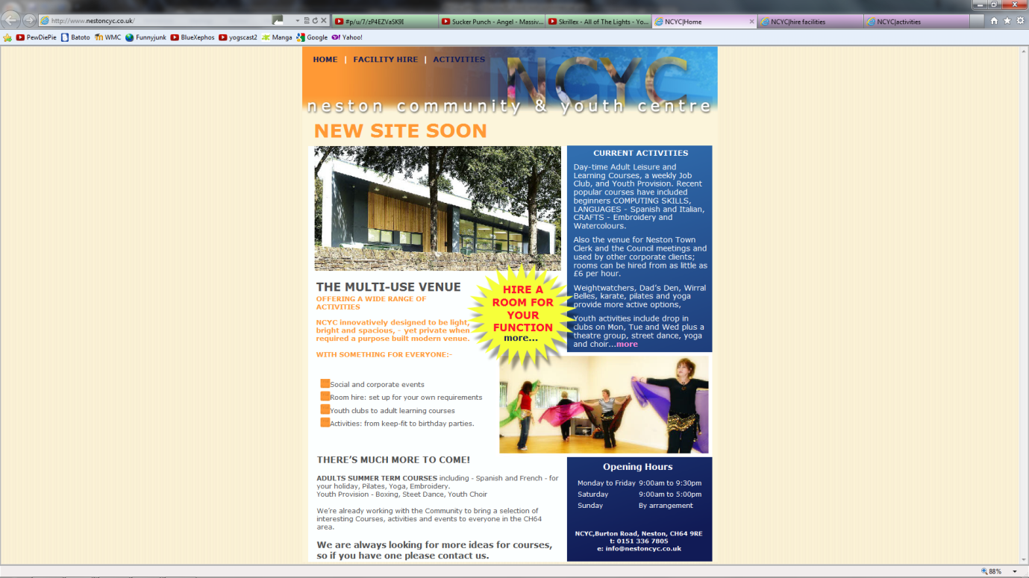
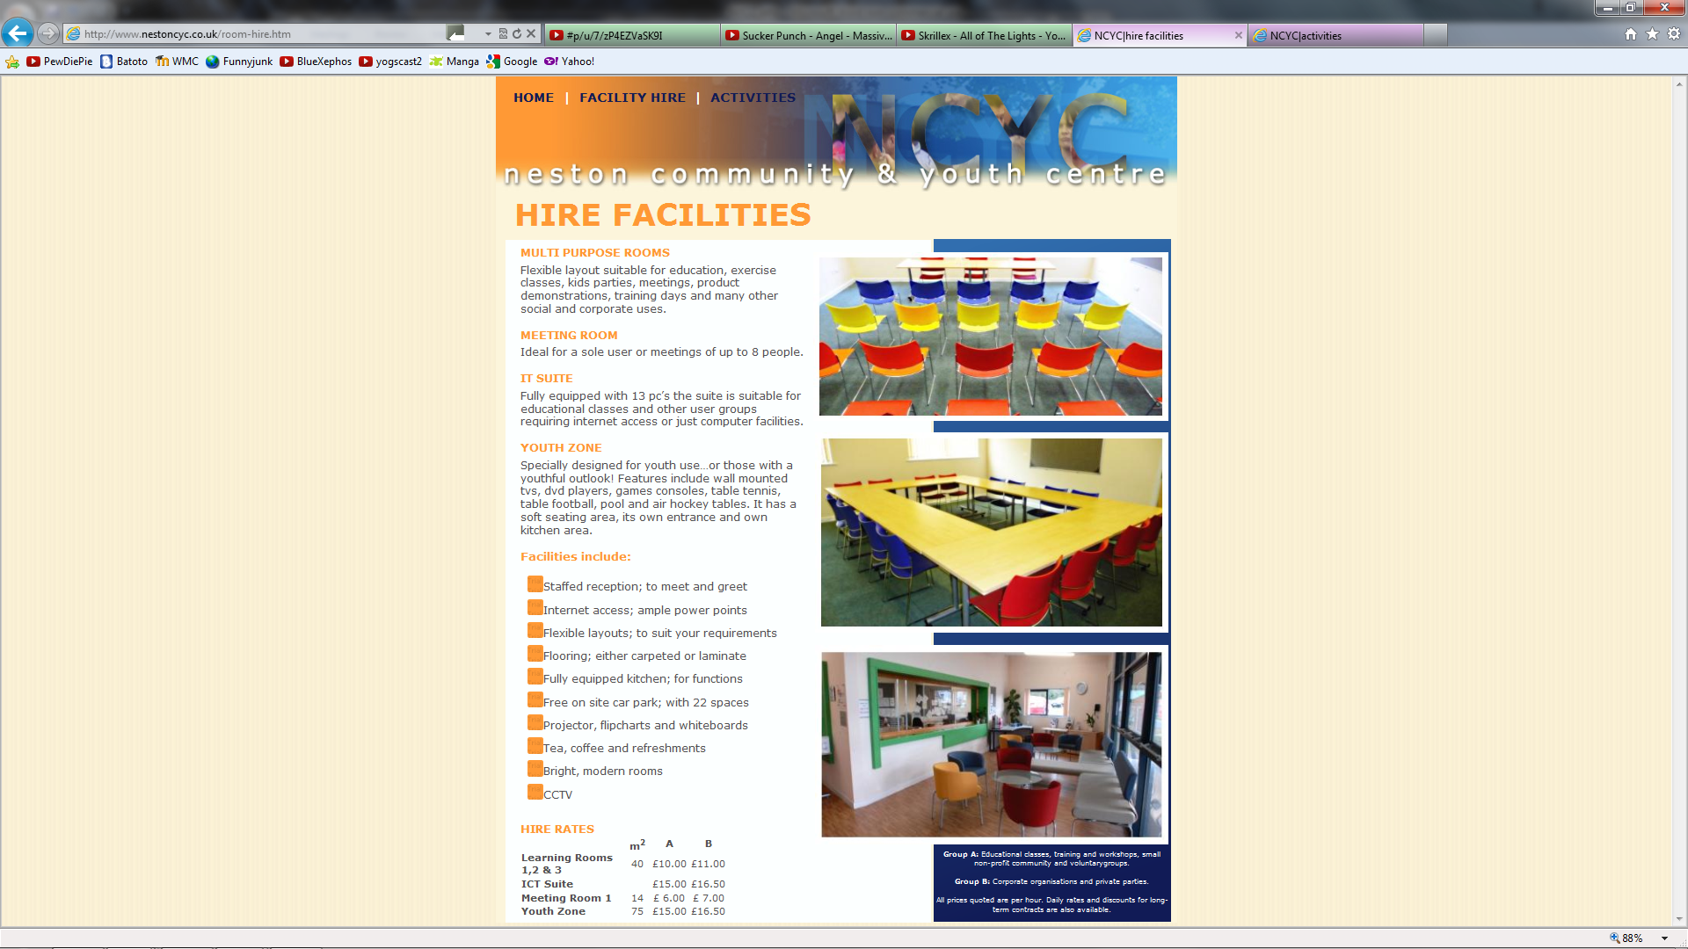
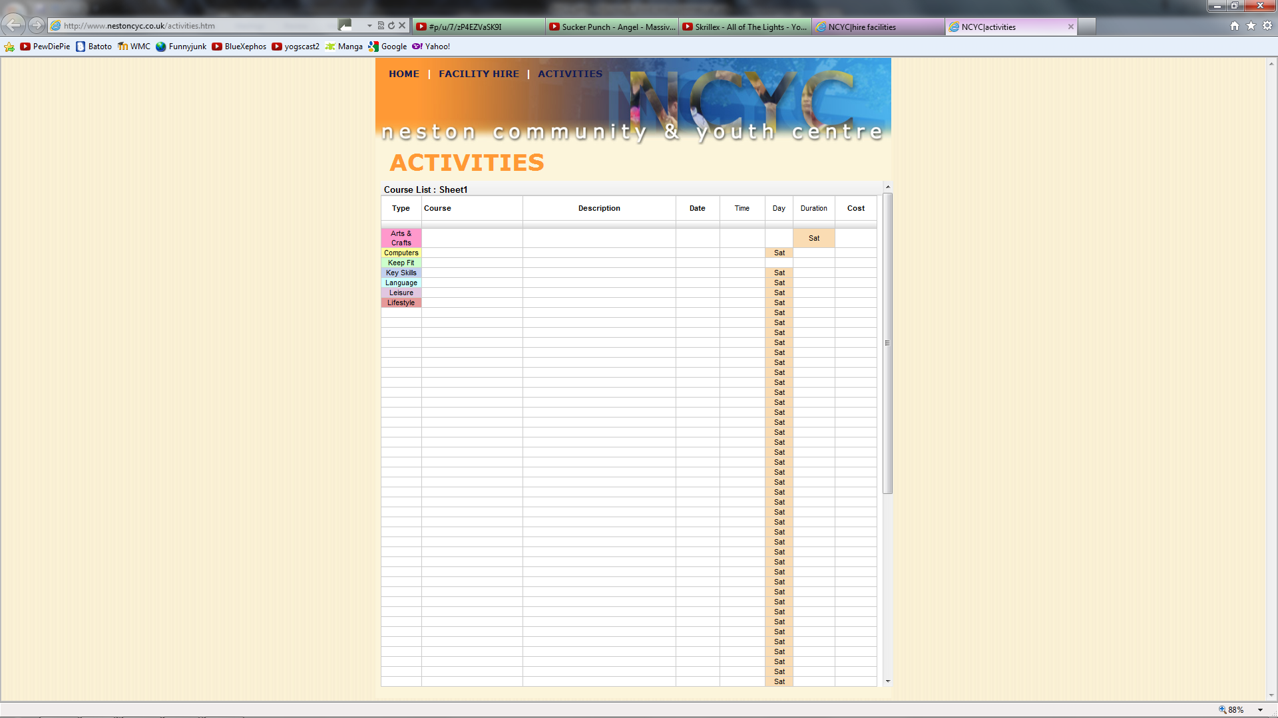
Create the website
Website created with staff approved designs
Notes:
After the design had been decided upon we began creating the website.
There were a few alterations in the design as we created it.
This website is up online until the new one is created.

Slide 8
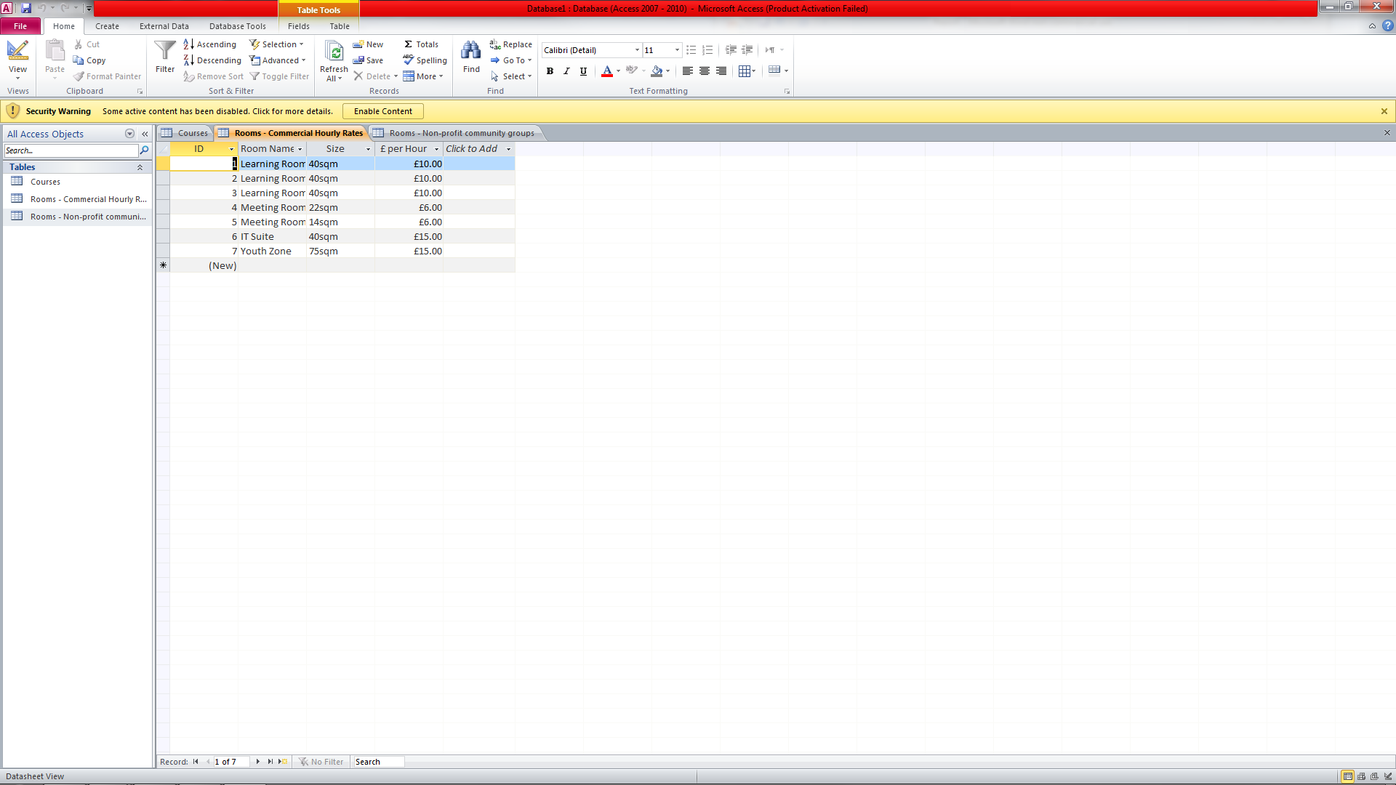
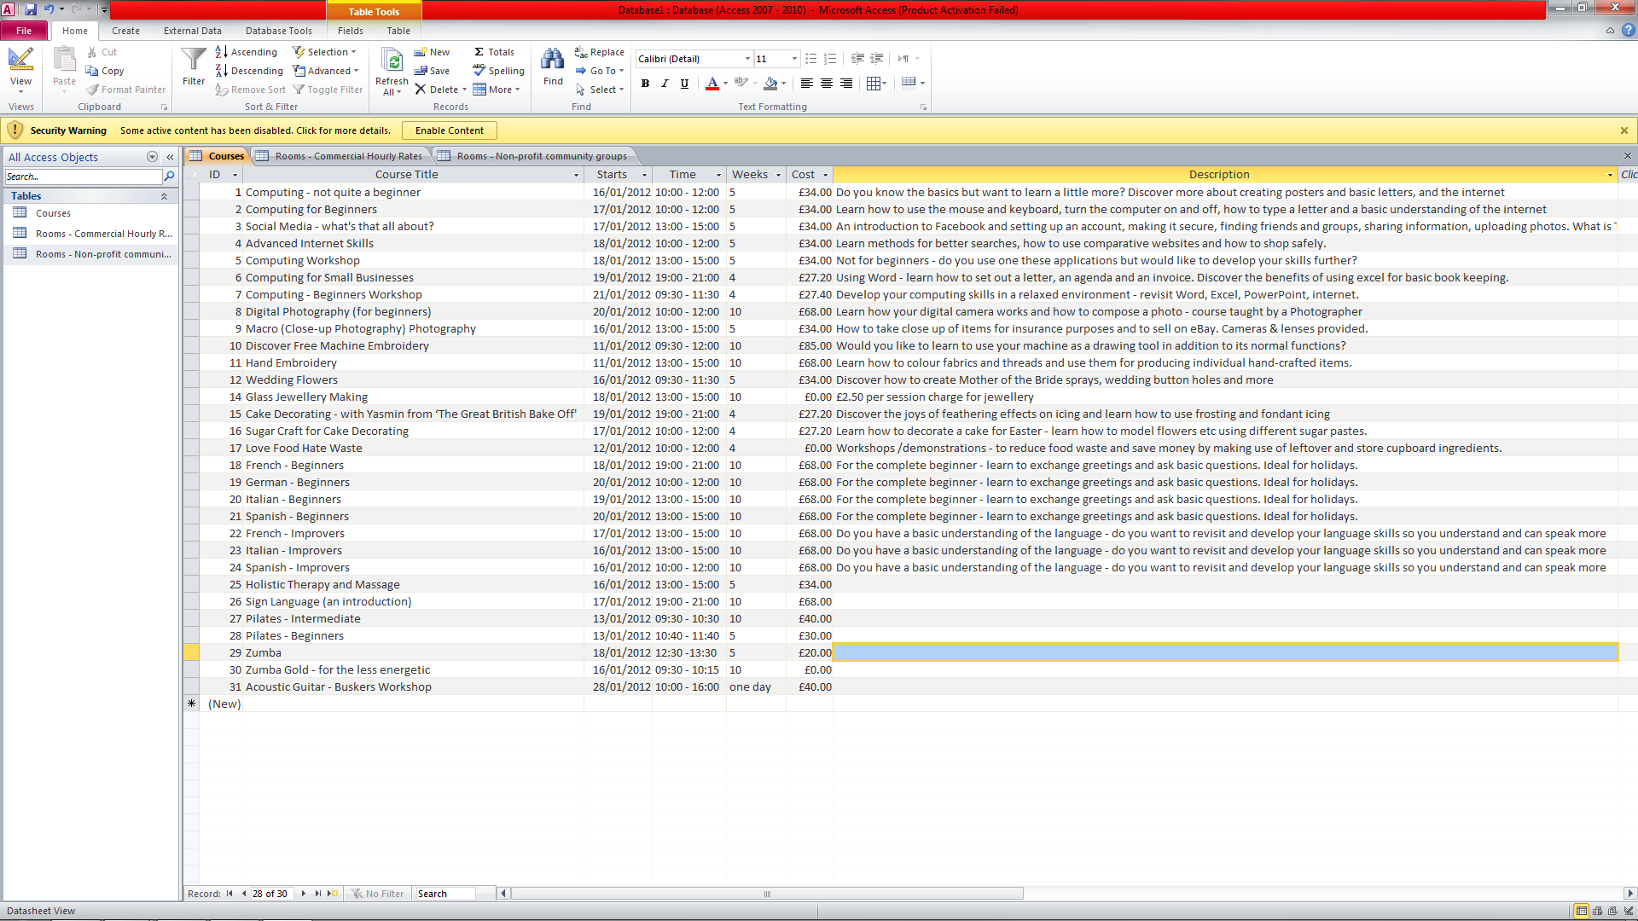
Build database
Create a database for courses and rooms
Notes:
Practical Target – create a database.
Created a database to store course and room details.
Will eventually be linked with website.

Slide 9

WeMakeJam
Got something to shout about?
We can help you find your voice online
Project to build a software tool
Designed for the voluntary sector
Funded by Nominet Trust
Notes:
After creating the website we started connecting with the WeMakeJam project.
1. Jam offers a straightforward way to create and look after a website for your organisation, along with somewhere to turn for help and inspiration if you get stuck. Building a friendly software tool, a helpful community and a tried-and-tested recipe for online sustainability and effectiveness.
2. Worked with not-for-profits groups to develop a practical digital strategy that makes things happen in the real world. Jam is designed especially for the voluntary sector: funded by the Nominet Trust to help not-for-profits and community groups communicate better online.
3. Helps formulate the online goals, express them effectively, and prompt visitors to take action. Helps focus on who you want to talk to, what you want to say to them, and what you need them to do.

Slide 10
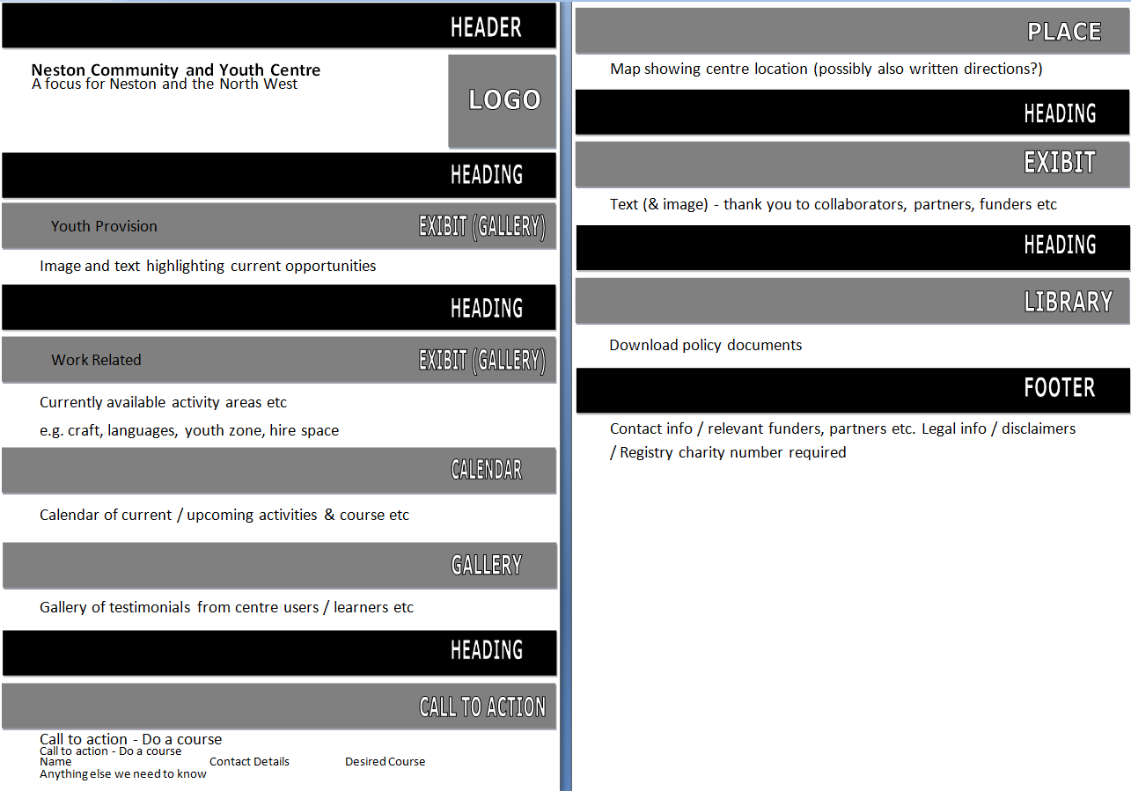
Plan design changes
Jam members advise redesign and invite NC&YC to Digital Identities
Redesign of
website into a
one-page website
Notes:
After Jam had taken a look at the current website design they advise changing the design to a single page website (shown)

Slide 11
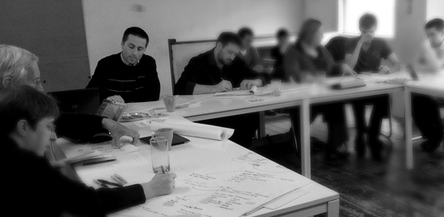

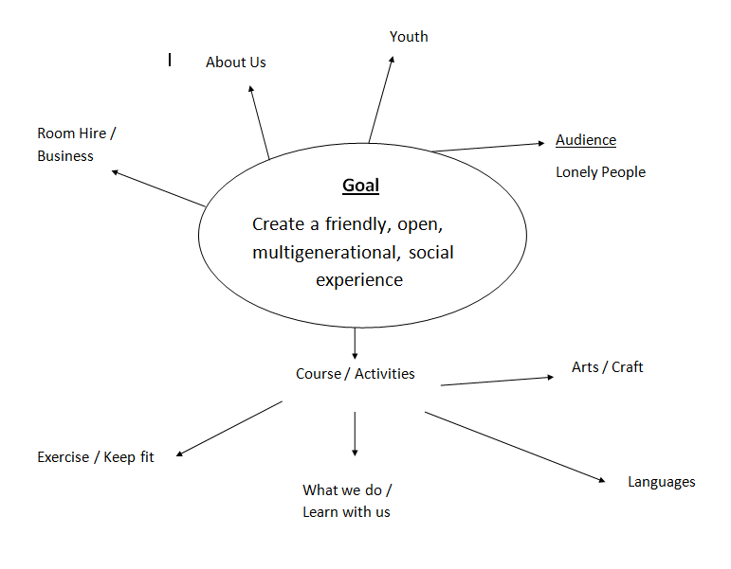
Digital Identities in Interesting Spaces
Held by Abhay Adhikari
Purpose to re-imagine organisation appearance
Notes:
Invited by Jam, held by Abhay Adhikari
One of the aims of this project is to enable organisations to re-imagine how they engage with digital media and social networks to make and engage new audiences online, to rethink the tagline in more detail and about the audience in more depth.
To do this there were many different activities to help such as creating mind maps.

Slide 12
Benefit to organisation
Up to date website knowledge
To aid design from a youth point of view
To be a link between WeMakeJam and NC&YC
Notes:
Up to date website knowledge – they had little to no knowledge
To aid design from a youth point of view – youngest
To be a middle man between WeMakeJam and NC&YC – as I could easily keep contact between each organisation without it affecting my work

Slide 13
Any Questions?

